Slide 1
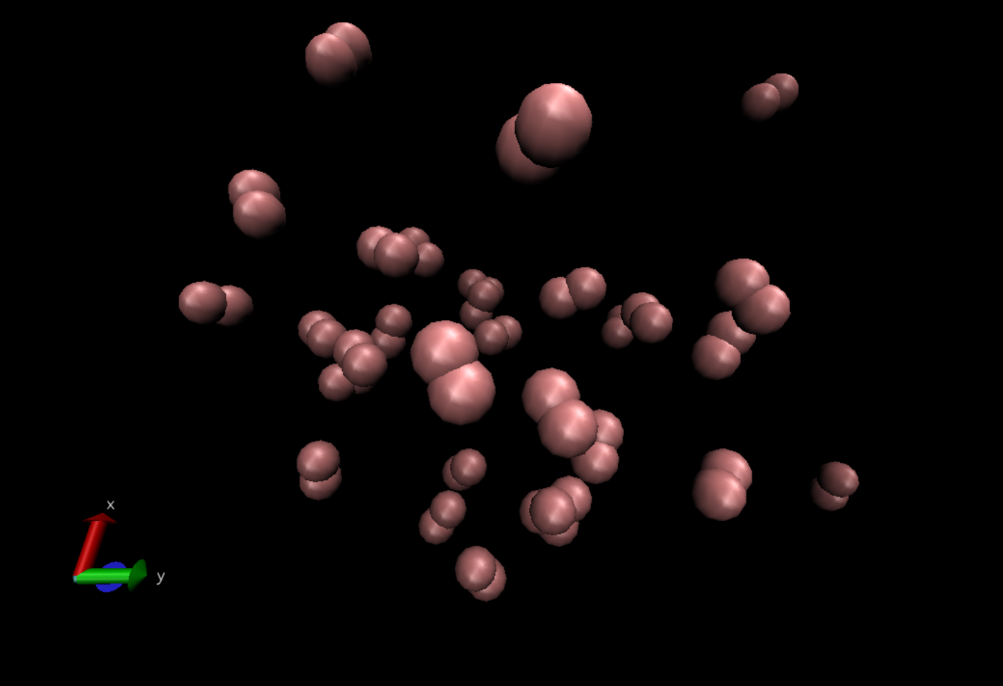
H₂ Simulation
Written in C++, visualized with VMD
Tommy Tran
Supervised by: Dr. Pengzhi Zhang

Slide 2
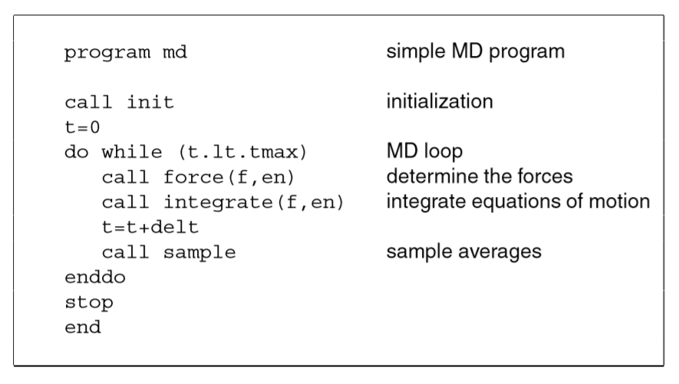
MD Algorithm

Slide 3
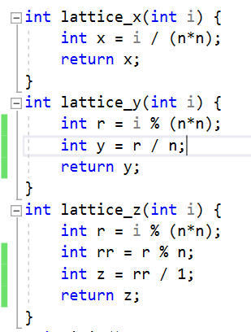
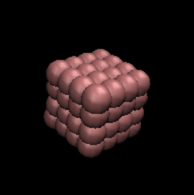
Initialize

Slide 4
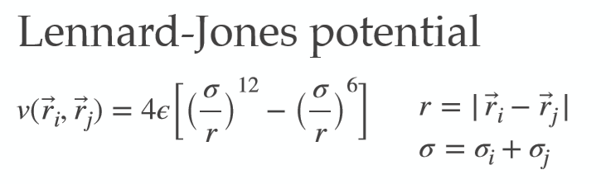
Lennard-Jones Potential
Lennard-Jones Potential is used to approximate the interaction between neutral atoms or molecules.
σ - radius of a hydrogen atom
r - distance between neighboring atoms

Slide 5
Reduced Units
Reduced units make things more convenient.
Quick Google search: “size of hydrogen atom”
53 pm (picometer) or 0.53 Å (Angstrom)
Length( 𝝈 ): Angstrom (1 Å = 1*10⁻¹⁰ m )
k (harmonic potential constant): [F/𝝈] or [E/𝝈²]
Δt (time) → 0.005[t] is 1.09*10⁻¹⁴[s]
T (temperature) → 1 T = 119.8K

Slide 6
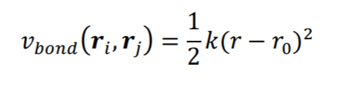
Bonded Interaction between H-H
Harmonic potential
r = √(x_{i}-x_{j})²+(y_{i}-y_{j})²+(z_{i}-z_{j})²
r₀ - equilibrium bond length
k - spring constant

Slide 7
dE_{b}/dx_{i} = ½ * k(2x_{i}-2x_{j}) - ( r₀(2x_{i}-2x_{j})/r )
dE_{b}/dx_{j} = ½ * k(2x_{j}-2x_{i}) - ( r₀(2x_{j}-2x_{i})/r )
dE_{b}/dy_{i} = ½ * k(2y_{i}-2y_{j}) - ( r₀(2y_{i}-2y_{j})/r )
dE_{b}/dy_{j} = ½ * k(2y_{j}-2y_{i}) - ( r₀(2y_{j}-2y_{i})/r )
dE_{b}/dz_{i} = ½ * k(2z_{i}-2z_{j}) - ( r₀(2z_{i}-2z_{j})/r )
dE_{b}/dz_{j} = ½ * k(2z_{j}-2z_{i}) - ( r₀(2z_{j}-2z_{i})/r )
r = √(x_{i}-x_{j})²+(y_{i}-y_{j})²+(z_{i}-z_{j})²

Slide 8
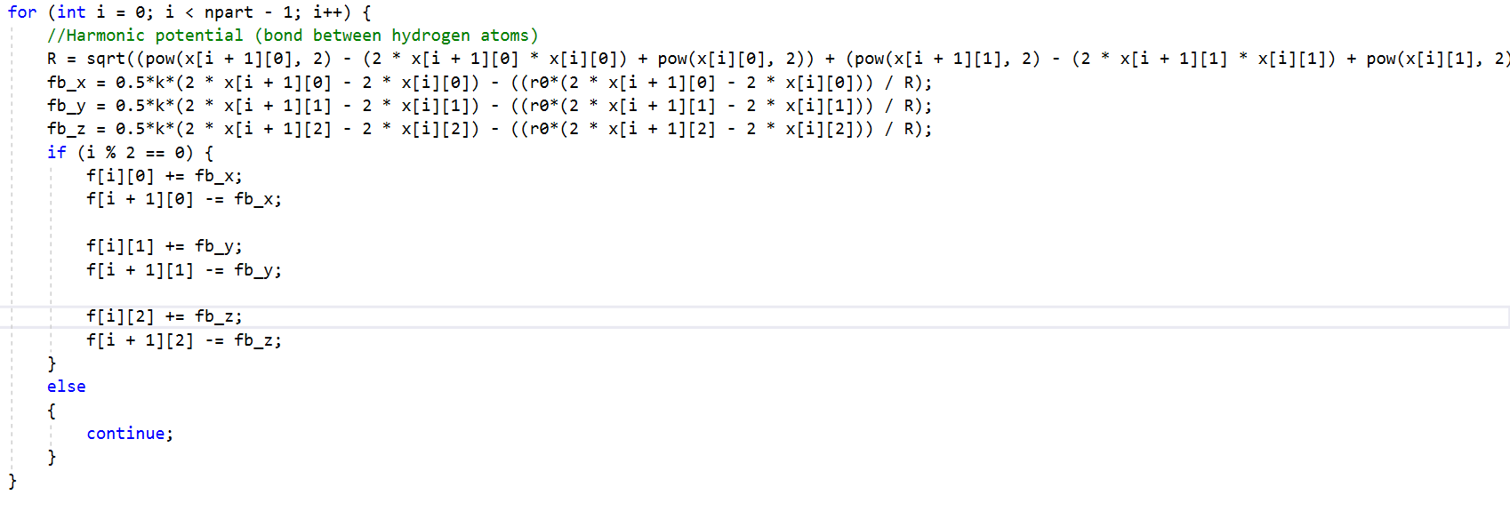

Slide 9
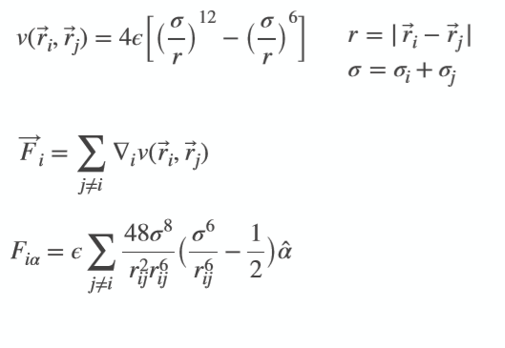
Force Calculation

Slide 10
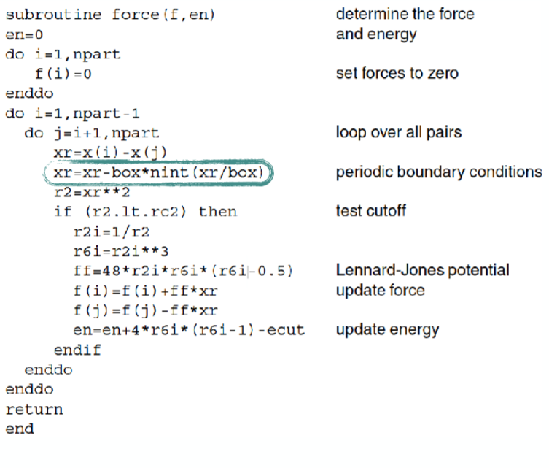

Slide 11
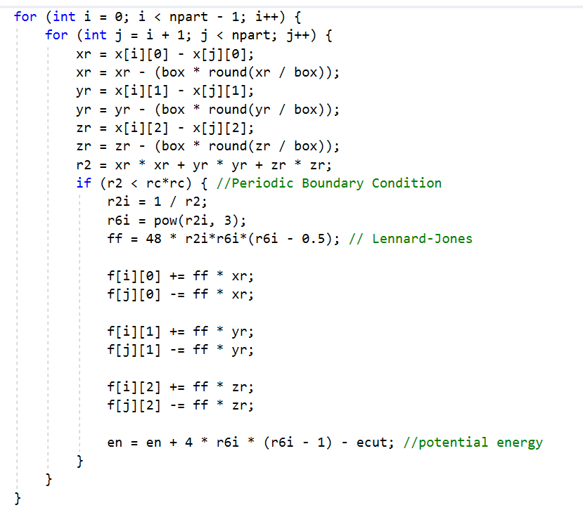

Slide 12
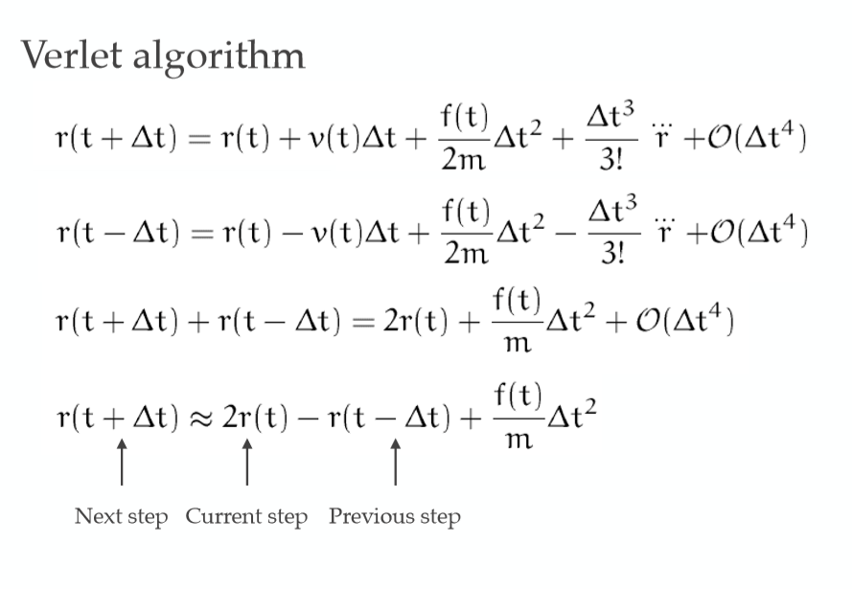
Verlet Algorithm

Slide 13
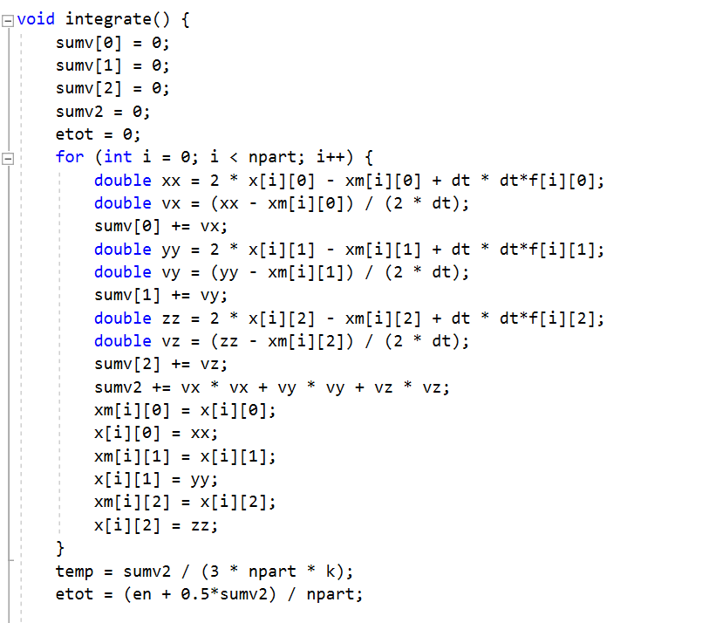

Slide 14
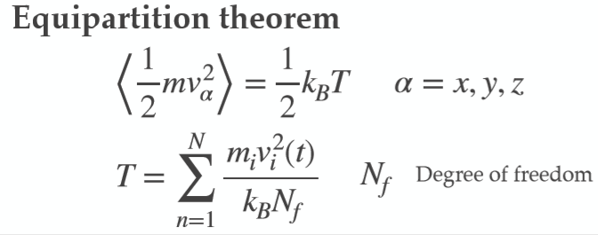
Temperature Calculation

Slide 15
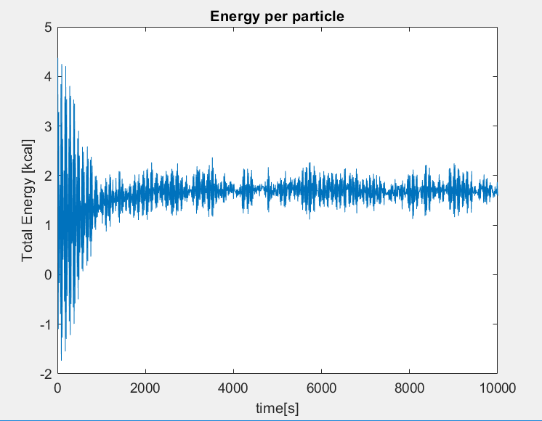

Slide 16
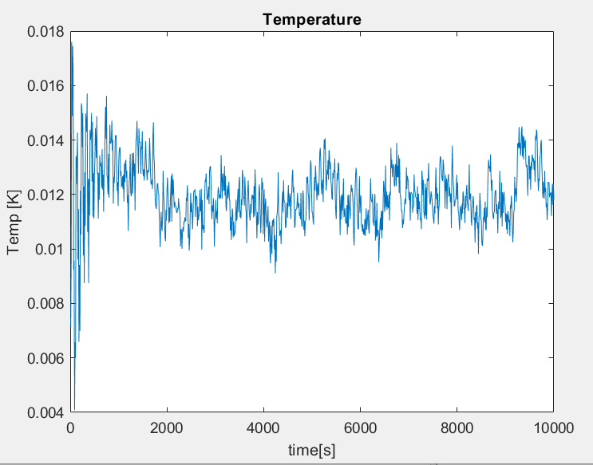

Slide 17
